Slide 1
Secure Data Hiding in Image Using Steganography
CAPSTONE PROJECT
Presented By: Pratik Erande
Student Name : Pratik Erande
College Name & Department : Suryadatta International Institute of Cyber Security, Department of Cyber Security.

Slide 2
OUTLINE
Problem Statement
Technology used
Wow factor
End users
Result
Conclusion
Git-hub Link
Future scope

Slide 3
Problem Statement
With the increasing need for secure communication, traditional encryption methods often attract attention from adversaries. Steganography provides an additional layer of security by hiding sensitive data within digital images, making it less detectable. This project aims to develop a secure and efficient technique for embedding and extracting hidden information in images while maintaining image quality and robustness against attacks. The objective is to enhance data confidentiality and integrity, ensuring secure communication in various cybersecurity applications.

Slide 4
Technology used
Python IDLE
OpenCV2

Slide 5
Wow factors
Unified Encryption & Decryption in One Script
Unlike many steganography tools that require separate scripts for encryption and decryption, your project seamlessly integrates both functionalities in a single codebase. This makes it more user-friendly and efficient.
Stealthy Data Hiding with Minimal Image Distortion
By embedding data in the Blue channel only, your project ensures that the image remains visually unchanged to the human eye while securely hiding the message inside.
Password-Protected Message Retrieval
Your project implements a passcode-based authentication system, preventing unauthorized users from decrypting the message, making it more secure than traditional steganography techniques.

Slide 6
End users
Cybersecurity Professionals & Ethical Hackers
Businesses & Enterprises
Researchers
Security Professionals

Slide 7
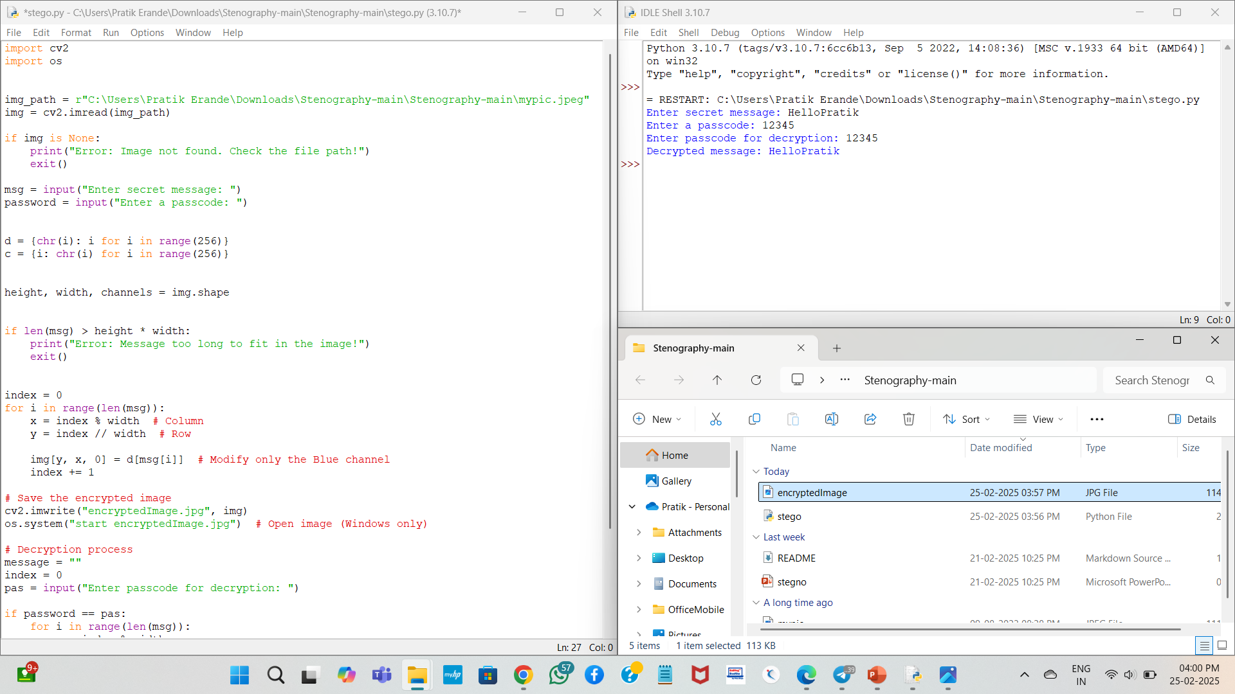
Results

Slide 8
Conclusion
Problem Statement:
In an era of increasing cyber threats and privacy concerns, secure communication methods are essential. Traditional encryption techniques often attract attention, while plaintext messages are vulnerable to interception. This project addresses the need for a covert data hiding mechanism by implementing image-based steganography, where messages are embedded within an image file without noticeable distortion.
Conclusion:
This steganography project provides a secure and efficient method for hiding confidential messages within images. By modifying only the Blue channel, it ensures that the image remains visually unchanged while embedding data. The password-protected decryption feature adds an extra layer of security, ensuring that only authorized users can retrieve the hidden message. The integration of encryption and decryption into a single script enhances usability while maintaining data confidentiality. Overall, this project demonstrates a practical and stealthy approach to secure communication.

Slide 9
GitHub Link
https://github.com/Pratik2840/aicte_project.git

Slide 10
Future scope(optional)
Support for Different File Formats
Currently, the project works with image files (JPEG/PNG). Future enhancements could extend support to audio (WAV, MP3), video (MP4), and document files (PDF, DOCX) for broader steganography applications.
Advanced Encryption Techniques
Integrating AES or RSA encryption before embedding the message would add an extra security layer, making the hidden data even harder to extract.
Improved Image Processing for Higher Capacity
Implementing LSB (Least Significant Bit) optimization or DCT-based steganography (used in JPEG compression) could allow larger messages to be hidden without affecting image quality.

Slide 11
THANK YOU

